Slide 1

Real-Time Adaptive Lane Detection for Indian Roads
Developing intelligent systems for safer autonomous navigation in diverse traffic conditions

Slide 2
Team Members :
Dayyala Pranay
Hall No. 2203A52013
Kanchu Kushi Raj
Hall No. 2203A52030
Kolluri Aniritha
Hall No. 2203A52032
Nalla Jeshwanth Kumar
Hall No. 2203A52043
Ranga Vihasith
Hall No. 2203A52049

Slide 3

"The main challenge in lane detection is maintaining stability under different lighting and road conditions. My goal was to reduce fluctuations and make detection consistent across frames."
Indian roads present unique challenges—varying illumination, diverse weather patterns, and inconsistent lane markings demand robust detection algorithms that adapt in real time.

Slide 4
Project Objectives & Implementation
Primary Objectives
Technical Implementation
The objective of this project is to develop a reliable system that detects lanes, calculates offsets, and provides stable visual feedback using hybrid smoothing techniques.
I implemented this system in Python using OpenCV and NumPy. The project was executed on Google Colab for easy video uploads and visualisation.
Accurate lane boundary identification
OpenCV for image processing
Real-time offset calculation
NumPy for numerical computations
Stable visual feedback mechanism
Google Colab for cloud-based execution
Adaptive filtering for noise reduction
Seamless video handling workflow

Slide 5
System Architecture & Pipeline
Upload Input Video
1
Load driving footage for analysis
2
Extract Frames
Break video into processable frames
Apply Region of Interest Mask
3
Focus on relevant road area
4
Detect Edges & Lane Lines
Identify lane boundaries using Canny and Hough
Estimate Offset and Heading
5
Calculate vehicle position metrics
6
Apply Kalman + EMA Filtering
Smooth detection for stability
Annotate and Save Output Video
7
Generate visualised results
The process starts with uploading a video, isolating the region of interest, detecting lane edges, and then applying filters for smooth tracking. The final output is an annotated video with real-time metrics overlay.

Slide 6
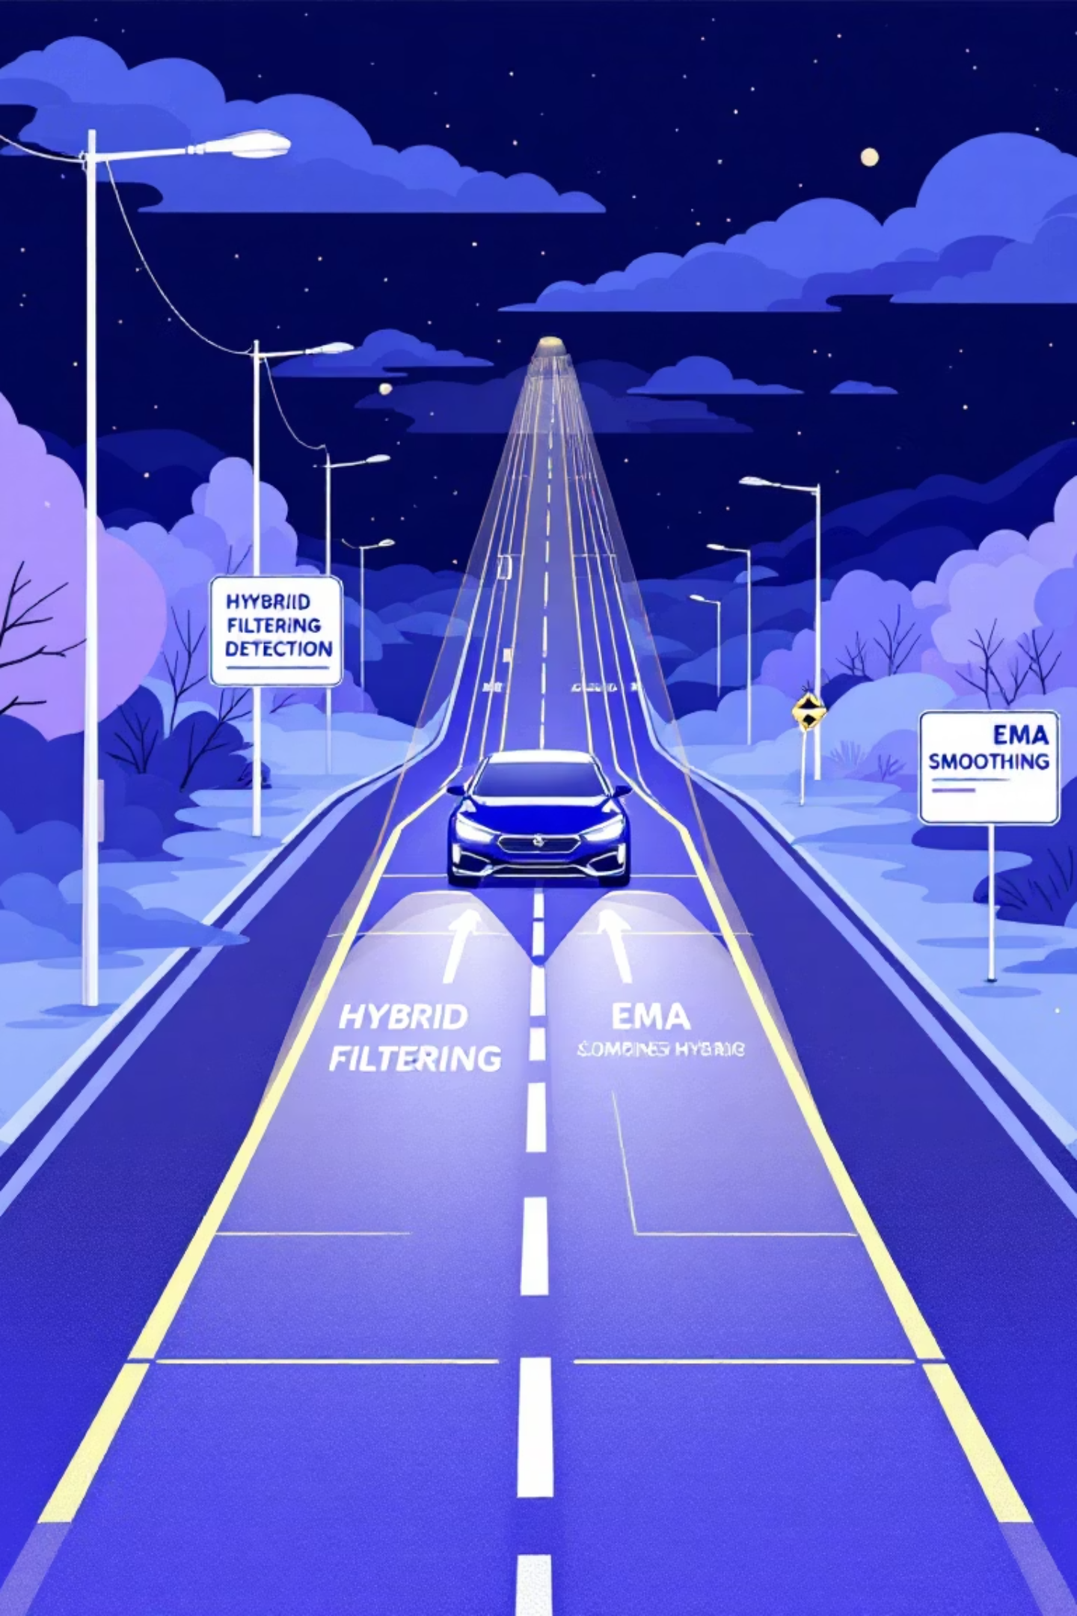
Hybrid Filtering Approach
Kalman Filter
EMA Smoothing
Hybrid Method
Works on predict → measure → correct principle
Combines Kalman prediction and EMA smoothing
Exponential Moving Average with smoothing factor α = 0.6
Estimates vehicle offset even with missing lanes
Produces hybrid offset = (Kalman + EMA) / 2
Filters noise in offset readings
Predicts future positions based on motion model
Balances prediction and smoothing
Gives more weight to recent observations
Achieves superior stability
Handles measurement uncertainty effectively
Reduces short-term jitter

Slide 7
Code Architecture & Modular Design
Initialisation Phase
Core Functions
Main Processing Loop
Video input configuration
average_slope_intercept() – Averages detected lane slopes
Iterates through all frames sequentially
Frame dimensions setup
Kalman filter parameters
region_of_interest() – Masks area of interest
Applies detection and filtering pipeline
EMA smoothing constants
detect_lanes() – Detects and draws lane lines
Computes real-time metrics
Writes processed output video
calculate_offset() – Computes vehicle offset
calculate_lane_width() – Measures lane dimensions
calculate_heading_angle() – Determines vehicle heading
The project is modularised into multiple functions handling detection, filtering, and metric computation. This architecture ensures code maintainability and allows easy integration of future enhancements.

Slide 8

Output Visualisation & Performance
Visual Elements
Performance Metrics
Green shaded lane area for clear boundary visualisation
These metrics help evaluate system performance:
Blue lane lines marking detected boundaries
High consistency percentage demonstrates reliable tracking
Real-time text overlays displaying:
Low offset difference indicates smooth transitions
EMA Offset value
Kalman Offset prediction
Stable heading angle shows accurate vehicle alignment
Hybrid Offset (combined metric)
Lane Width measurement
This hybrid method minimises errors and ensures a stable view of lanes even under complex driving conditions.
Heading Angle calculation
Output saved as output_video.mp4 with full annotations

Slide 9

Limitations & Future Scope
Current Limitations
Curved Lanes
Faded Markings
Lighting Variations
Struggles with sharp curves and complex road geometries
Reduced accuracy with worn or unclear lane markings
Performance depends on consistent illumination conditions

Slide 10

Conclusion
Hybrid System Development
Kalman + EMA Integration
Successfully developed a hybrid lane detection system using computer vision techniques
Combined Kalman Filter and EMA for reliable offset estimation and noise reduction
Real-Time Stability
ADAS Applications
Demonstrated stable lane tracking across varying conditions with minimal jitter
Applicable for autonomous driving and advanced driver assistance systems

